Slide 1
CIS-598 Project Unknown
Haoran An

Slide 2
Overview
Project Overview and Idea
Initial Design Diagrams
Current Problem
Tools
TimeLine
MVP
Version 1.0
Version 2.0

Slide 3
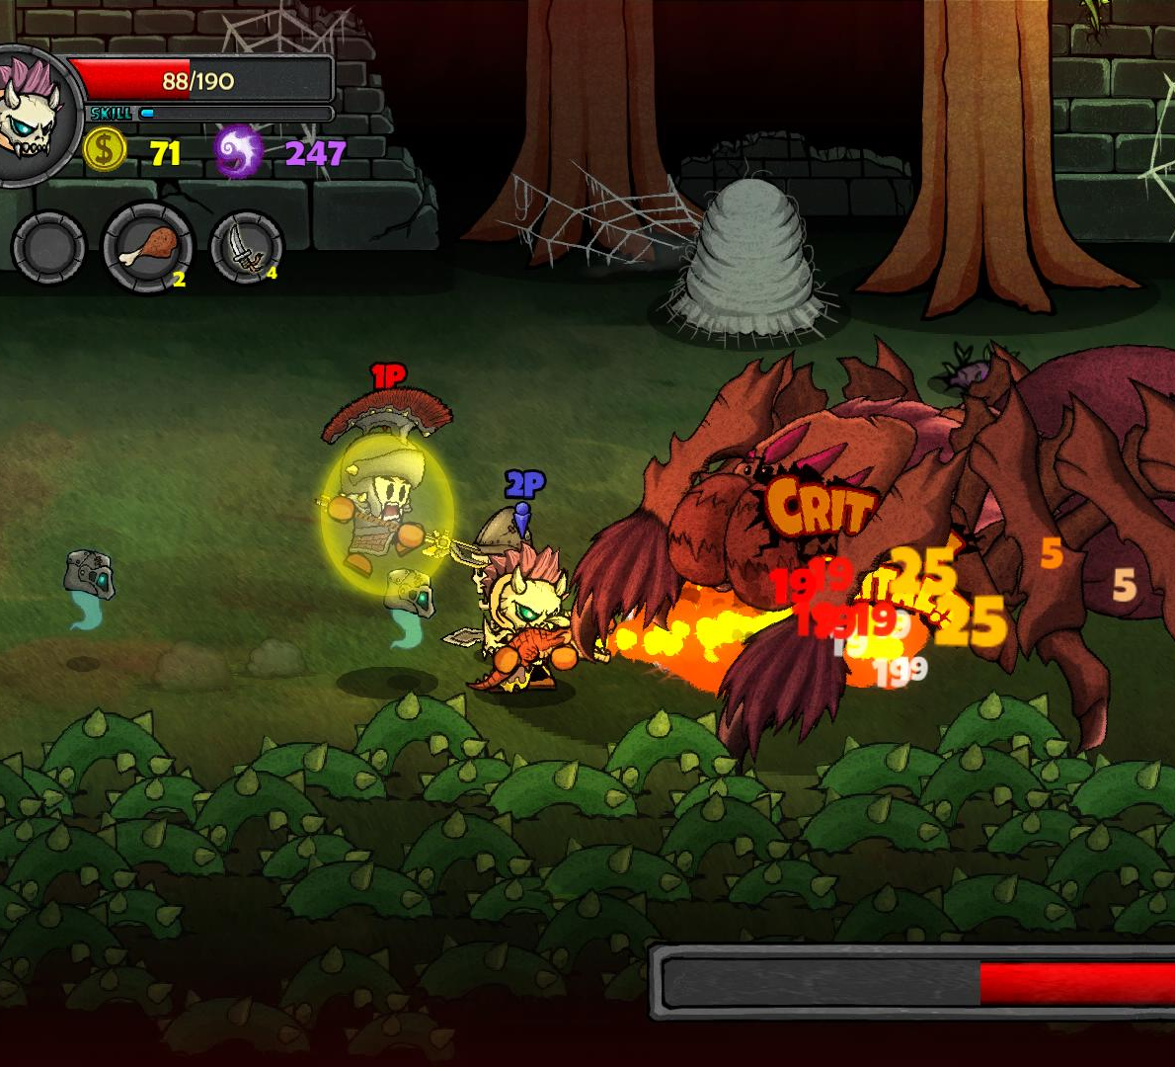
Project Overview and Idea

Slide 4
Initial Design Diagrams

Slide 5
Tools
Unity
C#
Visual Studio
Draw.io
Photoshop

Slide 6
Current Problem

Slide 7
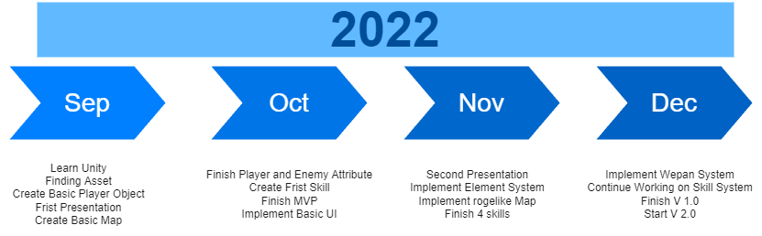
TimeLine

Slide 8
MVP
A basic player model, including all basic player actions
Move
Attack
Close range
Long range
Test skill
A basic Map
Map
Basic monster

Slide 9
Version 1.0
Finish the Skill system with different weapons
Now plan minimum 2 different weapons and 8 skills
Minimum 1 chapter and a boss
Basic UI
Menu
Save and Load

Slide 10
Future
Skill tree
Multiple elements skills
Scene Damage

Slide 11

Question?

